Slide 4

Object Classification
Project by,
Zeeshan Ahmed P
Sai Harshith Reddy
Tanmai Bhat
GROUP 3

Slide 5
Object Classification
Project by,
Zeeshan Ahmed P
Sai Harshith Reddy
Tanmai Bhat
GROUP 3

Slide 7
Image classification is one of the most common applications of Machine Learning.
The essence of Image classification is simply to take an image as input and predict what’s in it.
The model is trained to work with a set of predefined classes. These are the classes of objects the model can detect.
But why do image classification? The applications of image recognition and classification are endless. It is one of the vital components in robotics and self driving vehicle technology.
In recent years, Facial recognition has also found its use case in security systems. For example: Unlocking a smartphone by just looking at it.
INTRODUCTION

Slide 9
OVERVIEW

Slide 10
OVERVIEW
GOALS
RESULTS
The dataset was analyzed and was found to be imbalanced with some of the classes having over 18000 images and some having images as few as 900 in comparison.
Different feature extraction techniques were analyzed and Histogram of Gradients was chosen for building the model.
Model with an accuracy of ~86% was built and deployed on an Android application for real time classification.
Challenges faced:
Since the dataset contained 100000 images, it required a lot of computing resources and time to train.
Due to high imbalance in data, the model suffered to deliver good accuracy for minority classes.
The project aims at analyzing the traffic signal dataset.
The dataset contains images take from traffic cams all over the country.
Analyze different feature extraction techniques.
Work with dimensionality reduction for better results.
Analyze different models that can work with the given dataset to get better results.
Build a model that can train and classify images from 14 different classes.
Develop an Android application that is capable of using the built model to do real time predictions.

Slide 11
OVERVIEW
GOALS
RESULTS
The dataset was analyzed and was found to be imbalanced with some of the classes having over 18000 images and some having images as few as 900 in comparison.
Different feature extraction techniques were analyzed and Histogram of Gradients was chosen for building the model.
Model with an accuracy of ~86% was built and deployed on an Android application for real time classification.
Challenges faced:
Since the dataset contained 100000 images, it required a lot of computing resources and time to train.
Due to high imbalance in data, the model suffered to deliver good accuracy for minority classes.

Slide 12
TASKS

Slide 13
TASKS

Slide 14
TASKS
The 4 key sections of the project,
DATASET
DATA PROCESSING
APPROACH &
MODEL SELECTION
TRAINING &
VALIDATION

Slide 15
TASKS
The 4 key sections of the project,
DATA PROCESSING
DATASET
APPROACH &
MODEL SELECTION
TRAINING &
VALIDATION

Slide 16
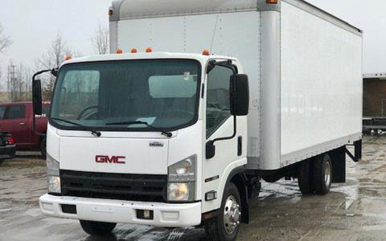
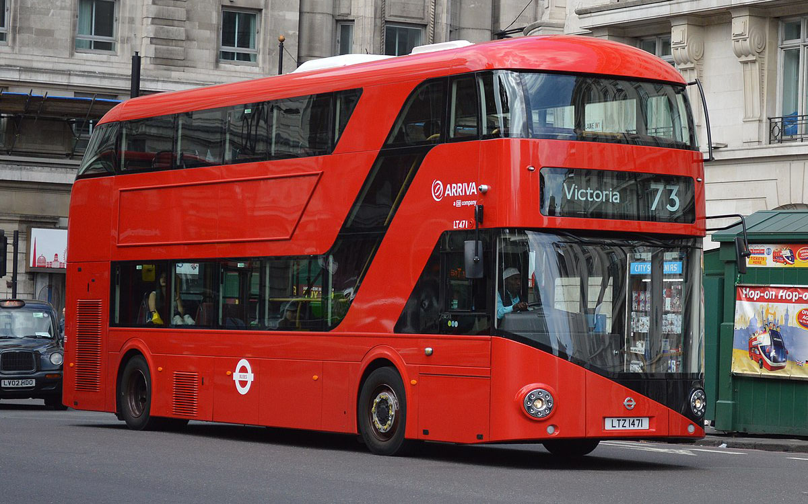
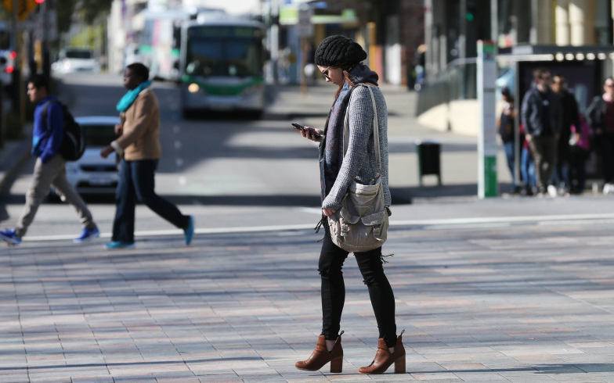
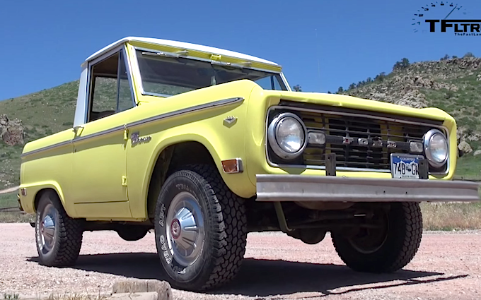
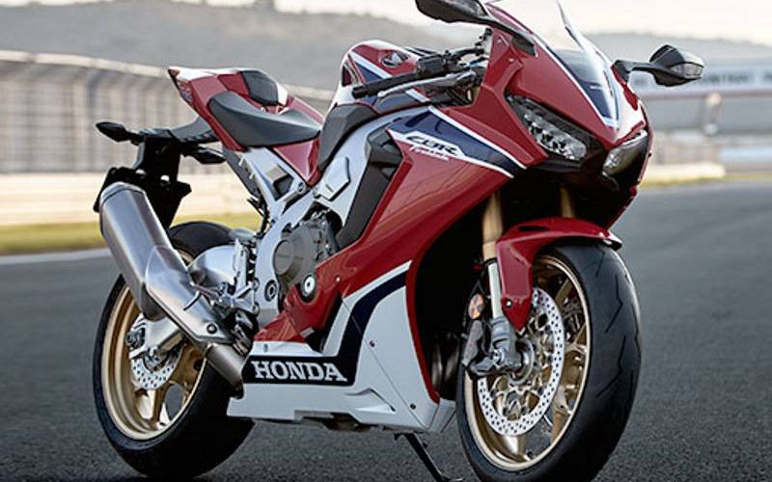
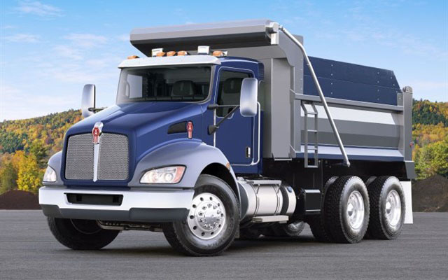
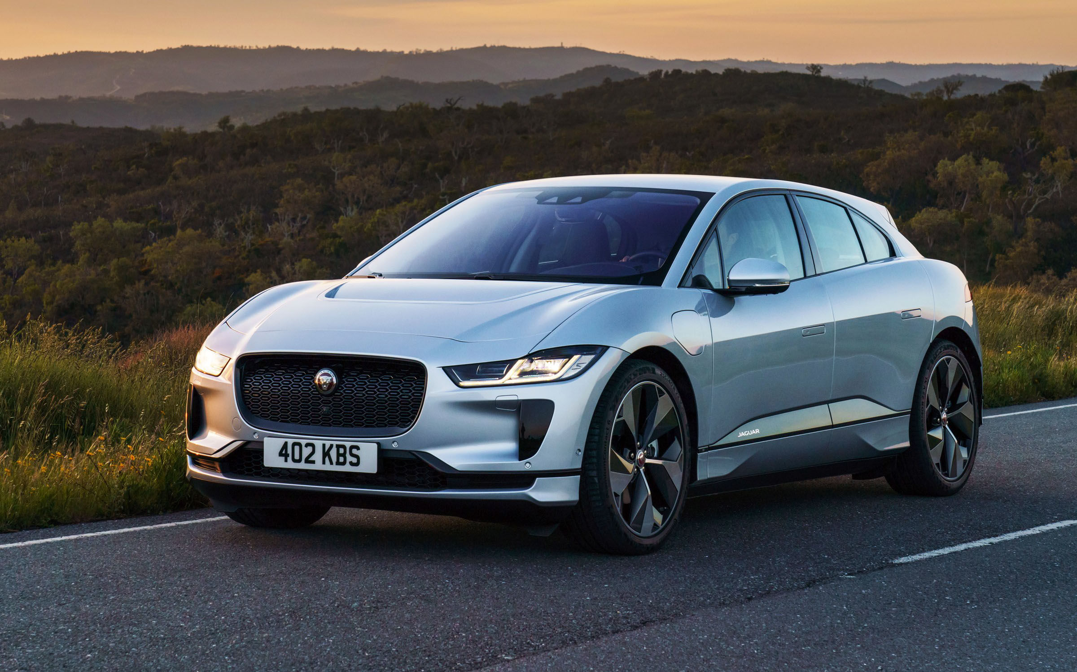
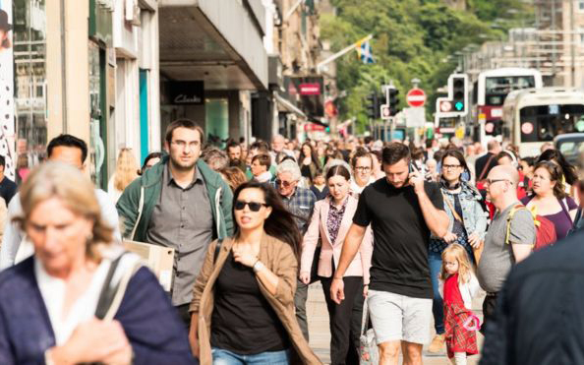
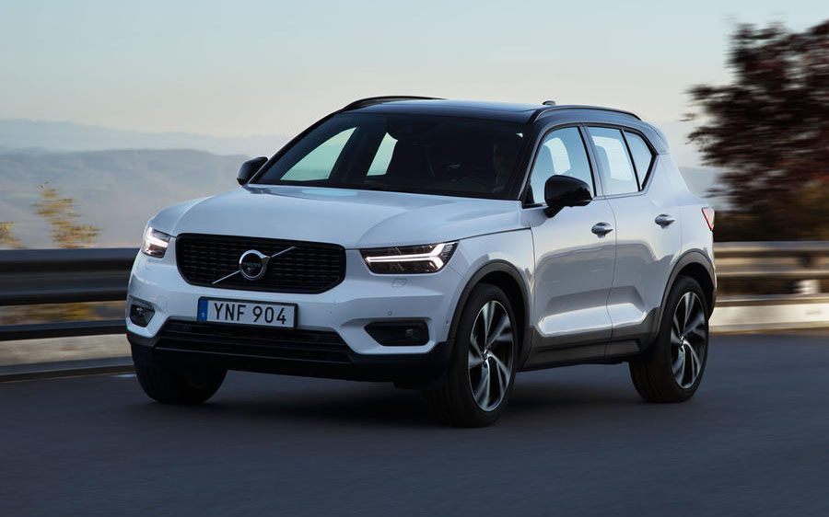
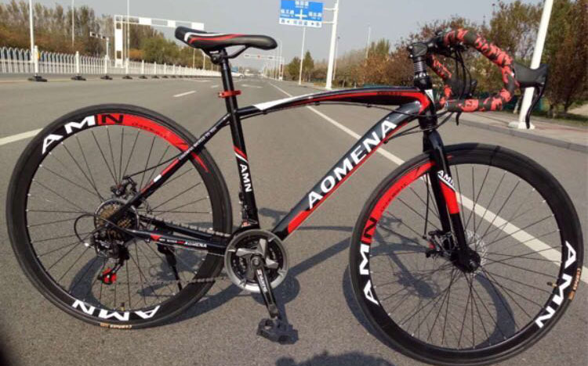
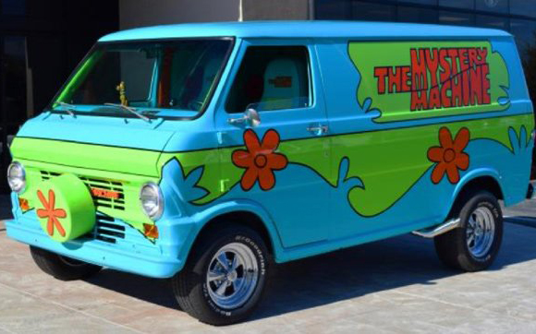
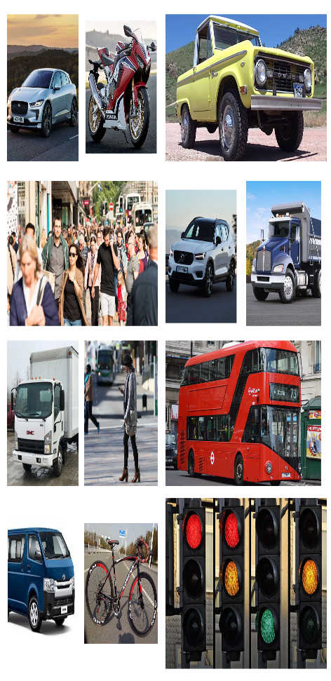
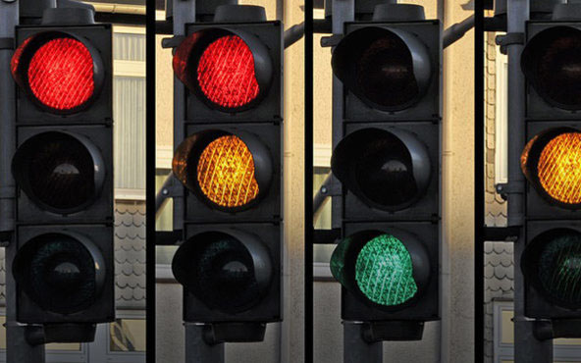
TASKS
The 4 key sections of the project,
DATA PROCESSING
APPROACH &
MODEL SELECTION
TRAINING &
VALIDATION
DATASET
The data set contains 100000 images.
It has images from 14 different classes.

Slide 17
TASKS
The 4 key sections of the project,
DATA PROCESSING
APPROACH &
MODEL SELECTION
TRAINING &
VALIDATION
DATASET

Slide 18
TASKS
The 4 key sections of the project,
DATASET
DATA PROCESSING
APPROACH &
MODEL SELECTION
TRAINING &
VALIDATION

Slide 19
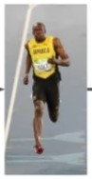
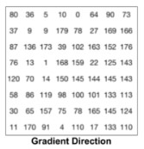
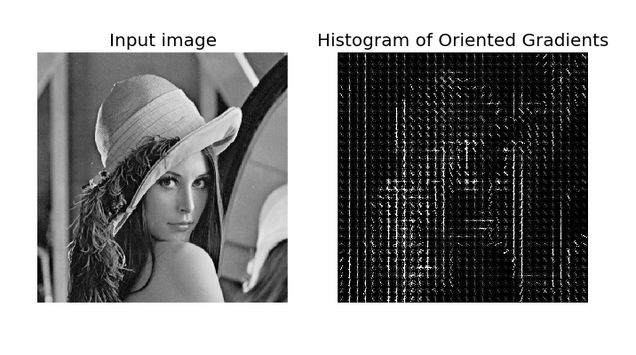
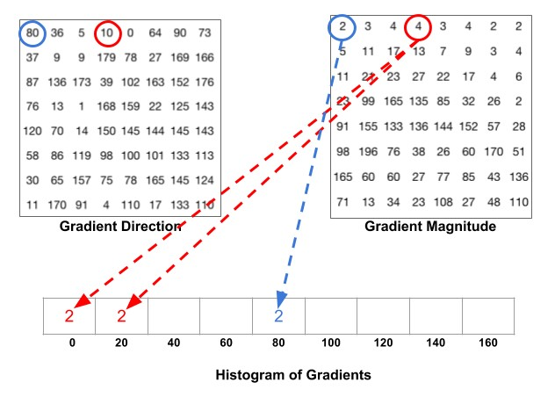
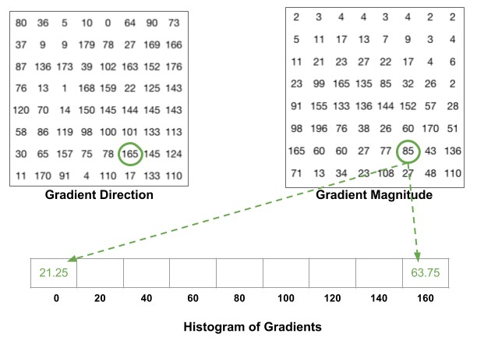
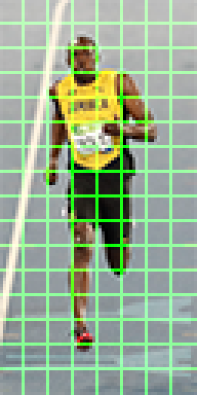
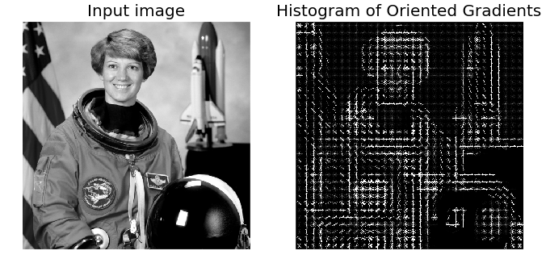
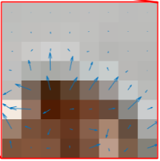
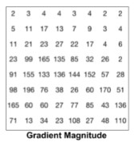
TASKS
DATA PROCESSING
The 4 key sections of the project,
The 4 key activities of the app are,
DATASET
MAIN ACTIVITY
TUTORIAL ACTIVITY
APPROACH &
MODEL SELECTION
SERVICE
TRAINING &
VALIDATION

Slide 20
TASKS
The 4 key sections of the project,
DATASET
DATA PROCESSING
TRAINING &
VALIDATION
APPROACH &
MODEL SELECTION

Slide 21
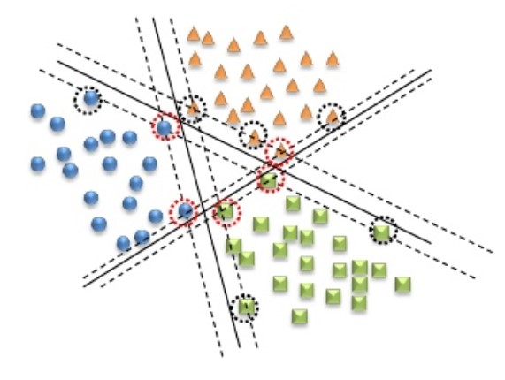
TASKS
APPROACH &
MODEL SELECTION
We tried both PCA and SVD for dimensionality reduction on the HOG matrix.
And finally SVM model was chosen with linear kernel, penalty of 10, and maximum iterations of 100000
The 4 key sections of the project,
The 4 key activities of the app are,
Input
Classes
DATASET
MAIN ACTIVITY
DATA PROCESSING
Conv Layer
Filter = 3x3
#Filters = 32
Conv Layer
Filter = 3x3
#Filters = 32
Conv Layer
Filter = 3x3
#Filters = 64
Flattened
Fully Connected Layer
TUTORIAL ACTIVITY
SERVICE
TRAINING &
VALIDATION
APPROACH
1 - CNN
2 - SVM

Slide 22
TASKS
The 4 key sections of the project,
DATASET
DATA PROCESSING
APPROACH &
MODEL SELECTION
TRAINING &
VALIDATION

Slide 23
OVERIEW
TRAINING &
VALIDATION
The 4 key sections of the project,
The 4 key activities of the app are,
DATASET
MAIN ACTIVITY
DATA PROCESSING
TUTORIAL ACTIVITY
APPROACH &
MODEL SELECTION
SERVICE
The preprocessed data was split. 80% of the data was used for training and 20% of it was used for validation.
The model was saved and used in an android application to check for performance with out of sample data.
The F1 score obtained for the model was 0.852

Slide 24
Lets check the demo now….

